Slide 1
PetCare
Smart Veterinary Clinic & Pet Health Management System
Project No.:
24
Team Members
Sai Nikhil Vukka_2500032630 (CSE )
G.V Sai Manikanta_2500080122 (AI&DS)
R.S.V.D.S Mohieswar_2500080124(AI&DS)
Section:
8
Language:
Java
Guide/Professor Name
Dr Surya Kiran Chebrolu
Review Date:
30-05-2026

Slide 2
ABSTRACT
As the pet caring landscape evolves, the demand for verified, data-driven veterinary management systems has become critical. This project presents PetCare, an ecosystem designed to optimize pet healthcare through advanced computational techniques. The platform streamlines the management of pet profiles, medical histories, and vaccination schedules while providing robust clinic analytics which is the stem of the project. The technical core of PetCare diverse consists of a multi-layered architectural approach utilizing specialized Data Structures and Algorithms to ensure high-performance operations. Balanced search structures, including AVL and B+ Trees, are implemented to maintain efficient O(log n) indexing and range(Type) queries for extensive medical databases to keep in track of the records . For regional healthcare connectivity, the system employs Graph Algorithms such as Dijkstra’s and Minimum Spanning Trees to facilitate proximity-based facility location and optimize networks with smaller costs . Furthermore, PetCare effectively bridges the gap between high-volume data management and real-time clinical decision support, ultimately enhancing the accuracy and accessibility across veterinary services.
Slide 2

Slide 3
PROBLEM STATEMENT
Modern Rescue systems process large amounts of transaction data daily. Traditional methods become slow and inefficient when handling large records.
This Systems require:
Fast account searching
Efficient rescue processing
Efficient on boarding systems
Optimized analytics to understand the status
The challenge is to Smart Veterinary Clinic design an using advanced Data Structures and Algorithms.
Slide 2

Slide 4
OBJECTIVES
Centralize Pet Health Management: Build a robust, scalable system to manage comprehensive pet profiles, medical histories, and active treatment records.
Optimize Clinic Operations: Streamline veterinary appointments, resource allocation, and scheduling workflows to minimize pet wait times and maximize clinic efficiency.
Enhance Healthcare Network Connectivity: Create an interconnected network of veterinary clinics to facilitate rapid referrals and resource sharing during emergencies.
Slide 3

Slide 5
DOMAIN / APPLICATION DESIGN
Domain
Core Entities
Veterinary Clinic & Pet Health Management
Pet Rescue
Treatment
Appointment
Architecture
Vaccination
Clinic
Java CLI with nested menus (one per DSA module with context ) and data screen (CSV / Raw mode)
Package Structure
petcare.models
petcare.utils
petcare.menu
petcare.trees
petcare.graphs
petcare.sorting
petcare.algorithms
Slide 4

Slide 6
SELECTED DATA STRUCTURES & Structure
Data Structures Used
PetCare/
├── PetCareApp.java
├── data/
│ └── pets.csv
├── models/
│ ├── Pet.java
│ ├── Treatment.java
│ ├── Appointment.java
│ ├── Vaccination.java
│ └── Clinic.java
├── utils/
│ ├── AppData.java
│ ├── CsvLoader.java
│ ├── DataGenerator.java
│ ├── DisplayUtils.java
│ └── InputUtils.java
├── menu/
│ ├── MainMenu.java
│ ├── StartupMenu.java
│ ├── TreesMenu.java
│ ├── MultiwayTreesMenu.java
│ ├── GraphsMenu.java
│ ├── ShortestPathMenu.java
│ ├── SortingMenu.java
│ └── GreedyDPMenu.java
└── sorting/
├── MergeSort.java
├── QuickSort.java
├── HeapSort.java
└── RadixSort.java
├── trees/
│ ├── BST.java
│ ├── AVLTree.java
│ ├── BTree.java
│ ├── BPlusTree.java
│ ├── SegmentTree.java
│ └── FenwickTree.java
├── graphs/
│ ├── Graph.java
│ ├── BFS.java
│ ├── DFS.java
│ ├── Kruskal.java
│ └── Prim.java
├── algorithms/
│ ├── Dijkstra.java
│ ├── BellmanFord.java
│ ├── FloydWarshall.java
│ ├── TopologicalSort.java
│ ├── ActivitySelection.java
│ ├── FractionalKnapsack.java
│ ├── ZeroOneKnapsack.java
│ └── LIS.java
BST
AVL Tree
B-Tree (order t)
B+ Tree
Segment Tree
Fenwick Tree
Graph (Adjacency List)
Priority Queue
Arrays
Slide 5

Slide 7
Modules
45 pre-loaded CSV pet records & 5 modules
M1 — Trees
M2 — Multiway
M3 — Graphs
AVL insert/search/delete · BST traversals · height comparison
B-Tree search · B+ Tree range query · Segment & Fenwick sums
BFS hop-distances · DFS components · Kruskal & Prim MST
M4 — Paths
M5 — Sorting
M6 — Greedy/DP
Slide 6
Dijkstra · Bellman-Ford · Floyd-Warshall · Topological Sort
Merge Sort (by cost) · Quick Sort (by frequency) · Heap/Radix — Soon
Coming Soon — Activity Selection · Knapsack · LIS

Slide 8
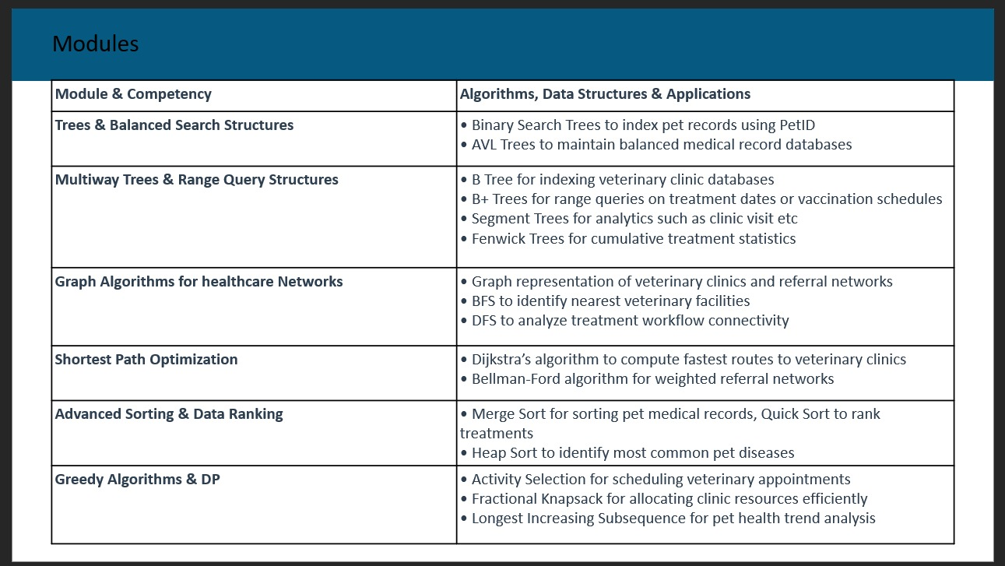
Modules

Slide 9
Technologies & Tools Used
Tool / Technology | Purpose
Java | Core Programming
VS Code | Development Environment
Java Collections | Data Handling
DSA Algorithms | Optimization
Terminal / CMD | Program Execution
Concepts Used
OOP
Arrays & Collections
Trees
Graphs
Sorting Algorithms

Slide 10
Input | Output
Module: 1 → AVL Trees → 2 (Insert) → Pet ID: 101 | AVL Insert: Pet ID 101 (Buddy - Dog) Height after insert: 1 Balance Factor: 0 ✓ Balanced
3 (Search) → Pet ID: 101 | `Found: ID=101
3 (Search) → Pet ID: 999 | [!] Pet ID 999 not found in AVL Tree.

Slide 11
Input | Output
Module: 4 → Shortest Paths → 1 (Dijkstra) → Source: 1 | Shortest distances from Clinic-1: To Clinic-2 : 4 km To Clinic-3 : 7 km To Clinic-4 : 9 km To Clinic-5 : 11 km
Source: 3 | To Clinic-1 : 7 km To Clinic-2 : 3 km To Clinic-4 : 2 km To Clinic-5 : 5 km

Slide 12
Input | Output
Module: 3 → Graphs → 1 (BFS) → Start Clinic: 1 | BFS from Clinic-1: Clinic-1 → 0 hops Clinic-2 → 1 hop Clinic-3 → 1 hop Clinic-4 → 2 hops Clinic-5 → 2 hops
Module: 5 → Sorting → 1 (Merge Sort) | Before Sort: `Surgery-A ₹5000

Slide 13
Input | Output
Module: 2 → Multiway Trees → 3 (B+ Tree Range Query) → From ID: 105 → To ID: 110 | B+ Tree Range Query [105 – 110]: `ID=105

Slide 14
Conclusion
PetCare successfully applies six DSA modules Trees, Multiway Trees, Graphs, Shortest Paths, Sorting, and Greedy/DP to real veterinary clinic problems like pet record indexing, inter-clinic routing, and appointment scheduling within a single cohesive Java CLI system. It bridges the gap between theoretical data structures and practical software, demonstrating that algorithms like AVL, Dijkstra, and Merge Sort directly solve real-world clinical challenges.
Future Advancements
Greedy & Dynamic Programming (M6 — Planned)
Database Integration
GUI / Web Interface
Machine Learning Integration
Real-Time Clinic Routing
Multi-User & Role-Based Access
Mobile Application

